Slide 1
Project 2 : EAT (AKA: BEATS)
Brian Sandoval
Erik Blomquist
Alexander Enaceanu
Tyler Kluszczynski
Shahid Karim(Lead)

Slide 2
Project Overview
Main Objectives.
CircleCI
AWS
IAM
ASG
S3
Route53
HashiCorp Packer
DataDog
Agent
Dashboard
Deployment of sites / Web Server Configuration

Slide 3
Team Overview
Tasks allocated to each team member:
Name | Tasks
Brian | Datadog, HashiCorp Packer, Deploy Websites
Erik | Datadog, HashiCorp Packer, Deploy Websites
Alex | Datadog, HashiCorp Packer, Deploy Websites
Tyler | CircleCI, IAM, ASG, Route 53, Deploy Websites
Shahid | S3, Web server configuration, Deploy Websites

Slide 4
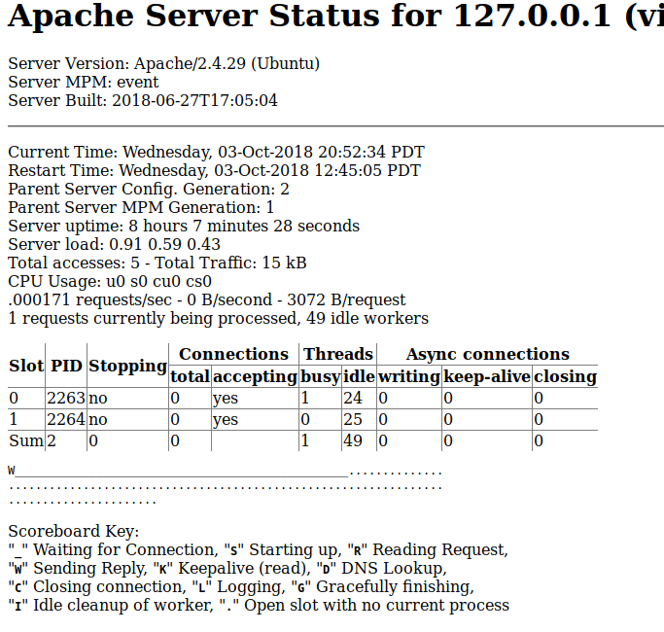
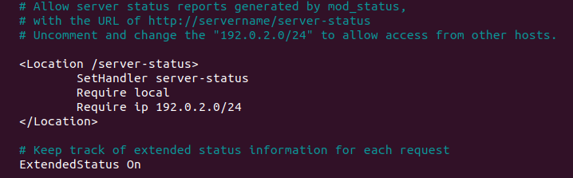
Brian - Tasks (Datadog)

Slide 5
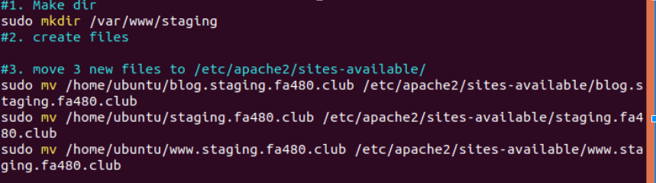
Brian - Tasks (Staging)

Slide 6
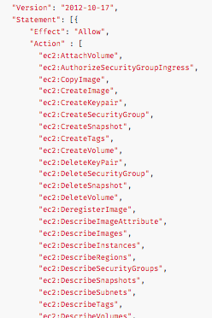
Erik - HashiCorp Packer
Download - https://www.packer.io/downloads.html Mac: $ brew install packer Windows: choco install packer
AWS Policy - Minimum permissions for packer to work (https://www.packer.io/docs/builders/amazon.html)

Slide 7
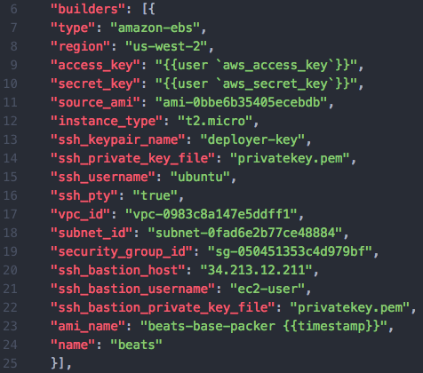
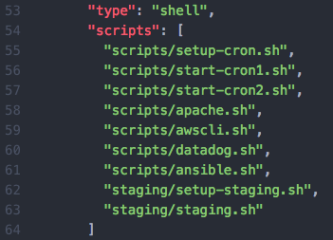
Erik - HashiCorp Packer
Build AMI - packer build -debug base_beats.json - builders - provisioners - Deregister AMIs or pay $0.01 / month

Slide 8
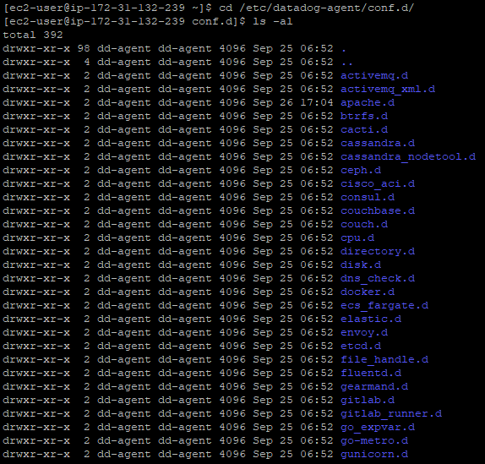
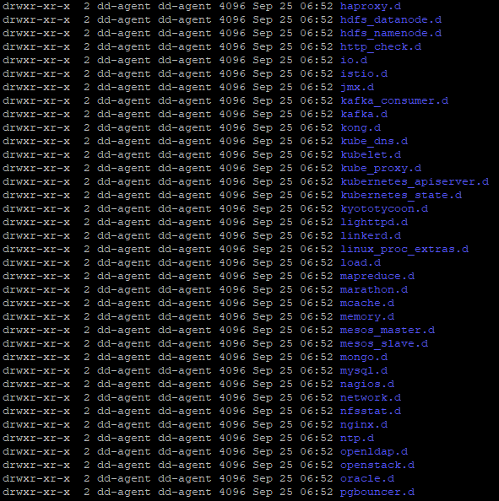
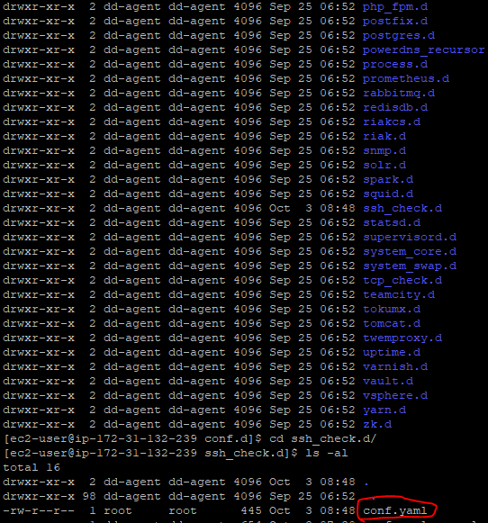
Alex - Tasks (Datadog)

Slide 9
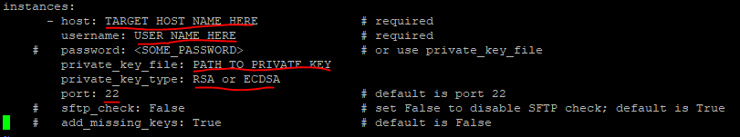
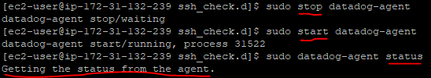
Alex - Tasks (Datadog)

Slide 10
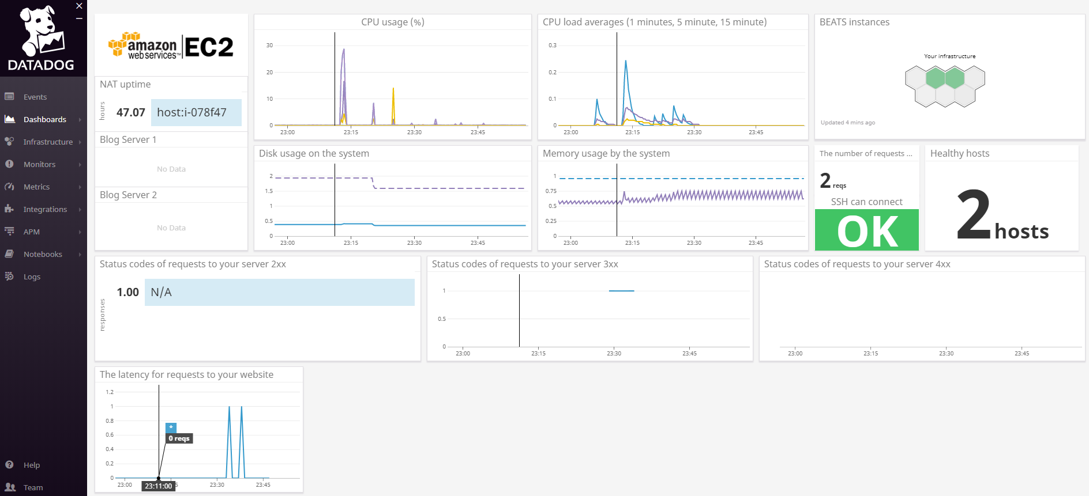
Alex - Tasks (Datadog Dashboard)

Slide 11
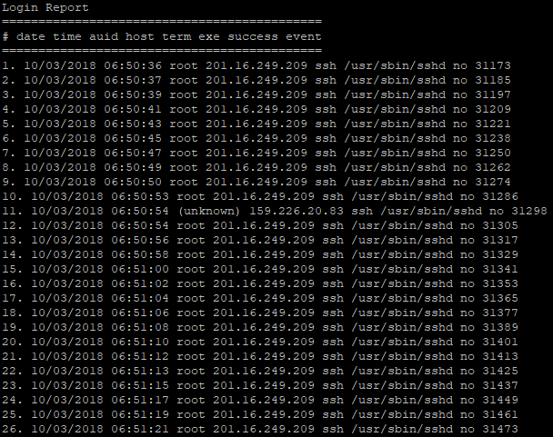
Alex - Tasks (Failed SSH attempts)

Slide 12
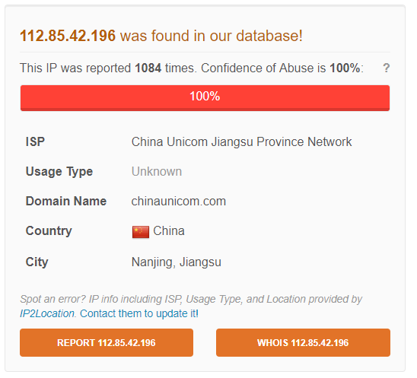
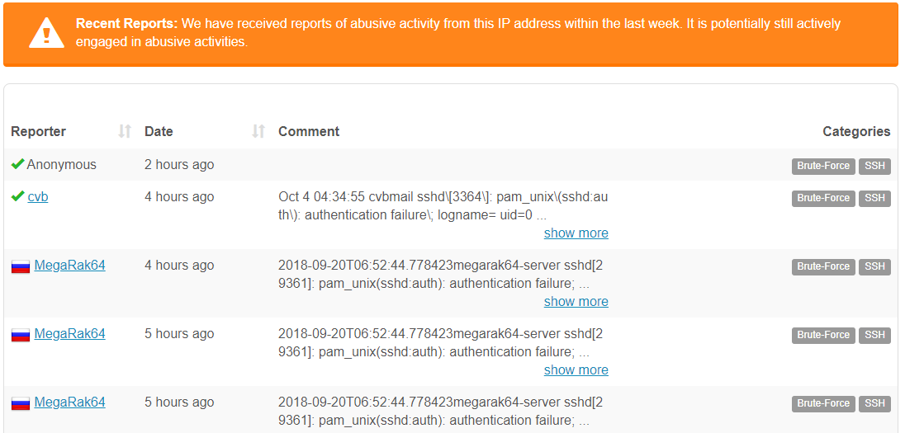
Alex - Tasks (Failed SSH attempts)

Slide 13
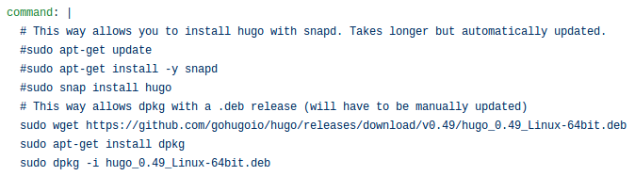
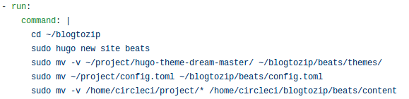
Tyler - Tasks (CircleCI - Config.yml)
Installing Hugo
Setting up Hugo to run

Slide 14
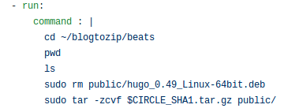

Tyler - Tasks (CircleCI - Config.yml)
Zipping blog
Uploading to S3

Slide 15
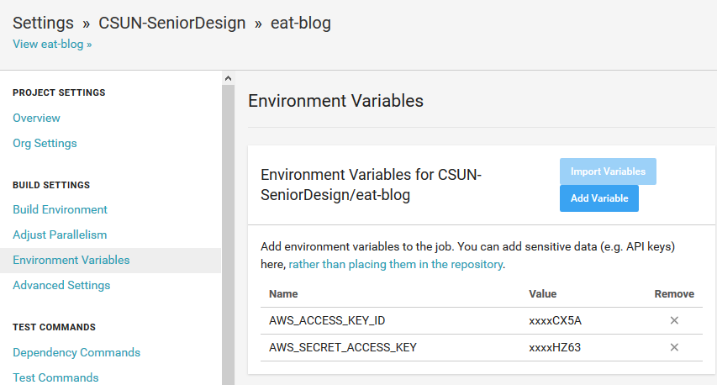
Tyler - Tasks (CircleCI - Environment Vars)

Slide 16
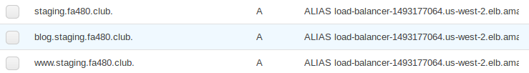
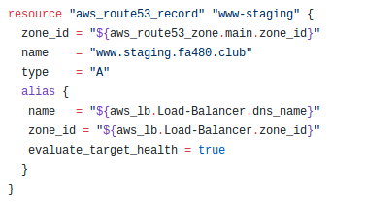
Tyler - Tasks (Route 53 for Staging)
Route 53 Records
Terraform code for www-staging

Slide 17
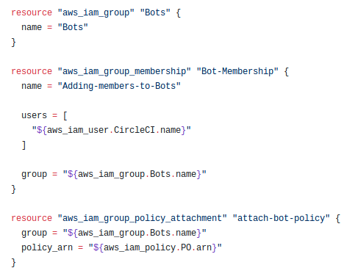
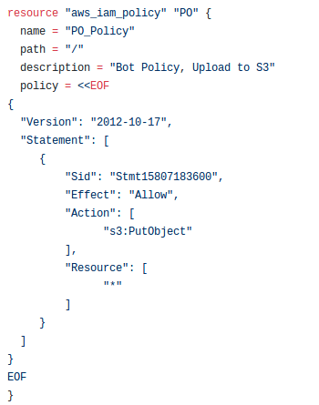
Tyler - Tasks (IAM - Circle CI)
CircleCI Bot and Group
CircleCI Bot Policy

Slide 18
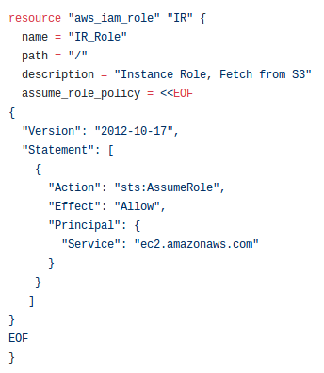
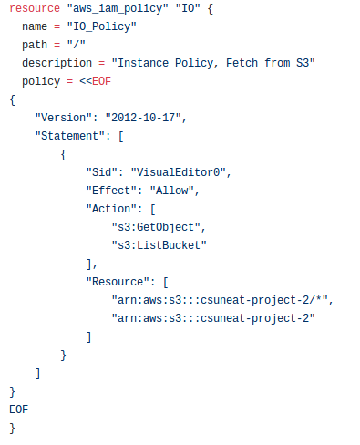
Tyler - Tasks (IAM - Instance Role & Policy)
EC2 Instance Role (Used in ASG)
EC2 Instance Policy

Slide 19
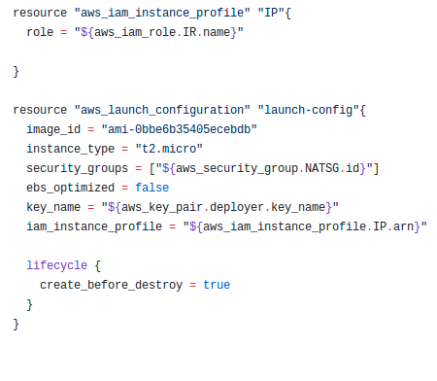
Tyler - Tasks (ASG - Launch Configuration)
ASG Launch Config & Instance Profile
This will be replaced with our AMI Image once it's complete.

Slide 20
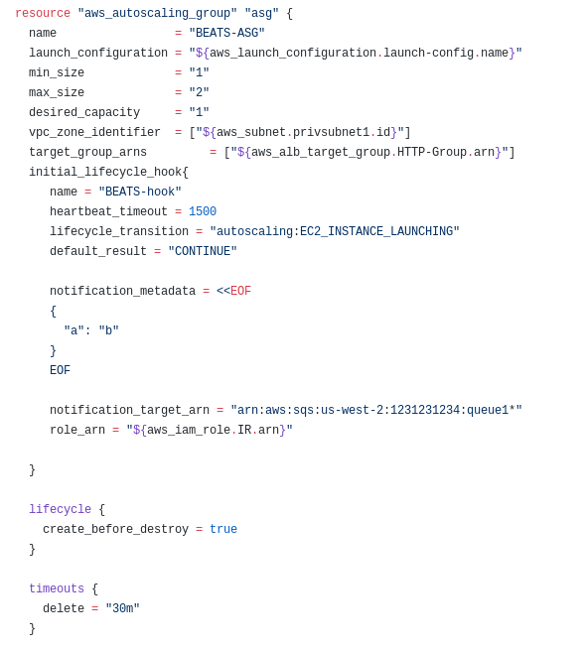
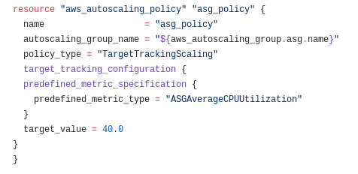
Tyler - Tasks (ASG)
ASG
ASG Policy

Slide 21
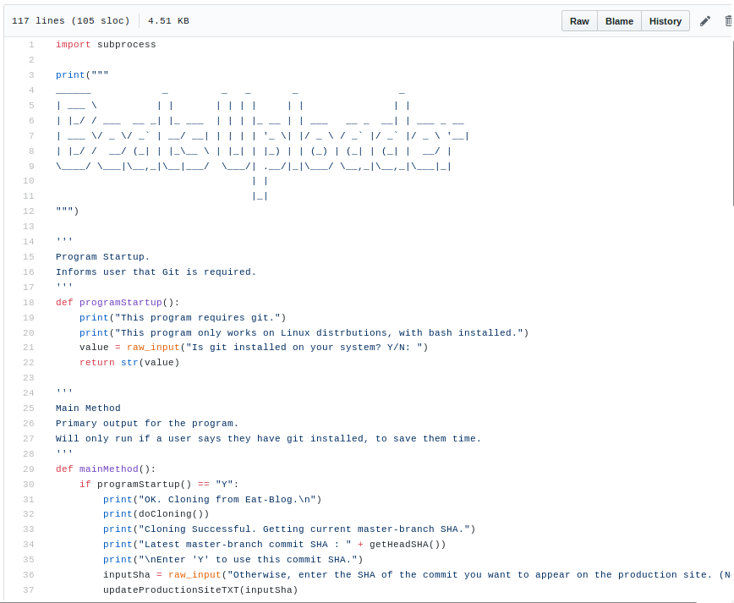
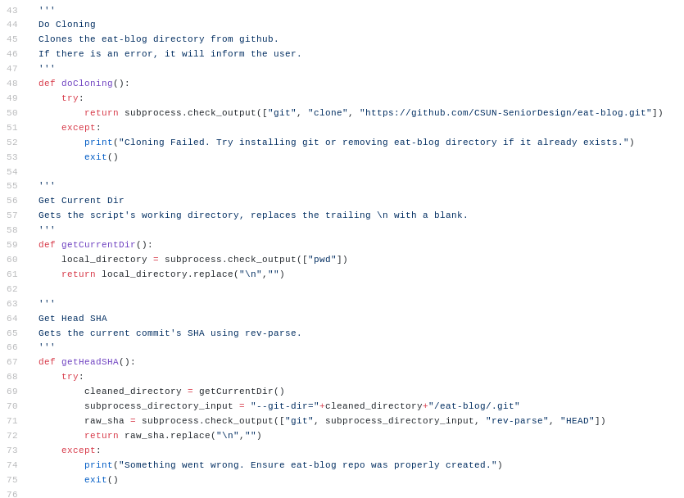
Tyler - Tasks (Python Scripts - BEATS Uploader)

Slide 22
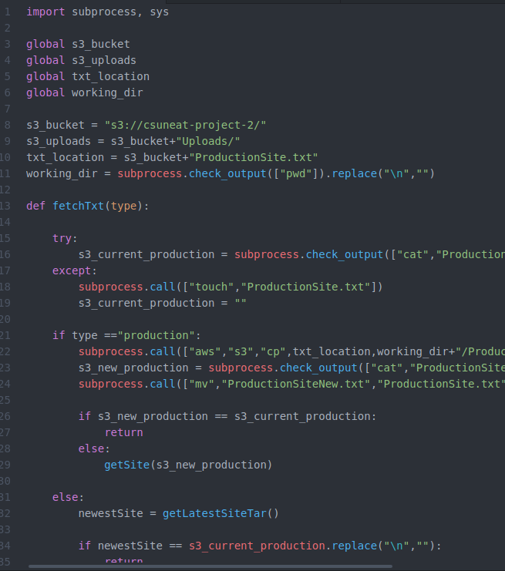
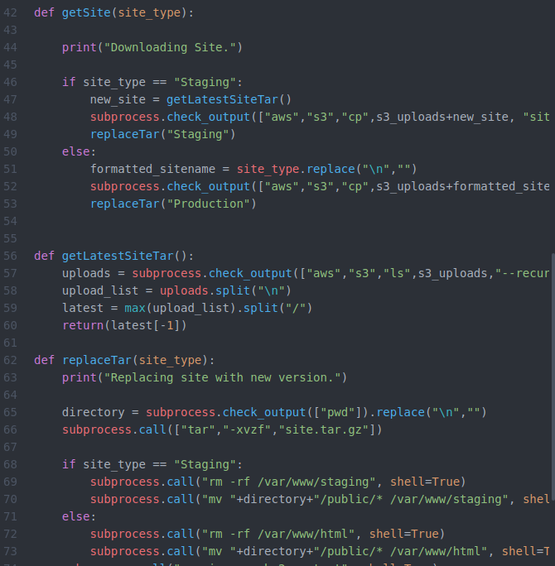
Tyler - Tasks (Python Scripts - Cron-job Script)
+
= 197 L.O.C. This wasn't factored in our work plan.

Slide 23
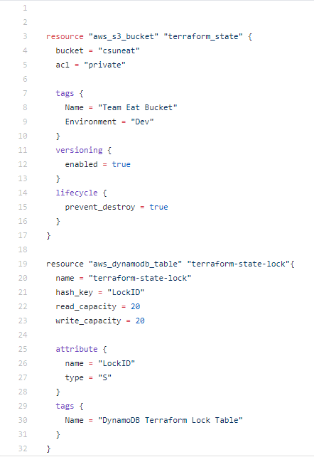
Shahid - Tasks(S3)

Slide 24
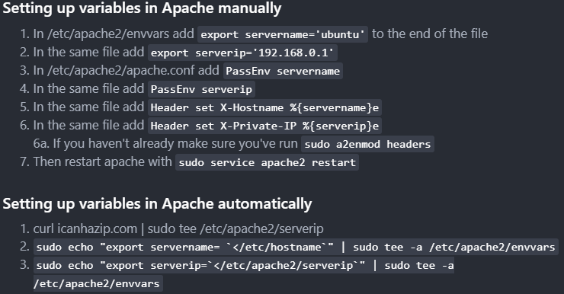
Shahid - Tasks(Web Server Configuration)

Slide 25
Issues and Lessons Learned
We encountered 2 major issues throughout Project 2.
No one had experience with Datadog and HashiCorp Packer.
We mainly researched using Google, and asked many questions to the professor.
A lot of time was spent trying to get both these sections done.
Work wasn't done as efficiently as we would have liked.
This project we implemented our revised task distribution we spoke about last project.
We had a bit of difficulty adjusting.
However, we were a bit less efficient in this project than the last.
In order to be even more efficient next project we need to have an initial meeting when the project specifications are revealed in order to gauge our perception of how long a task should take and how much manpower needs to be assigned to each task.
More information on the next couple slides

Slide 26
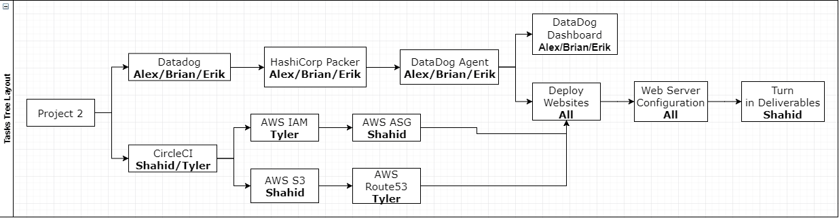
Project 2 - Example using the new system.

Slide 27
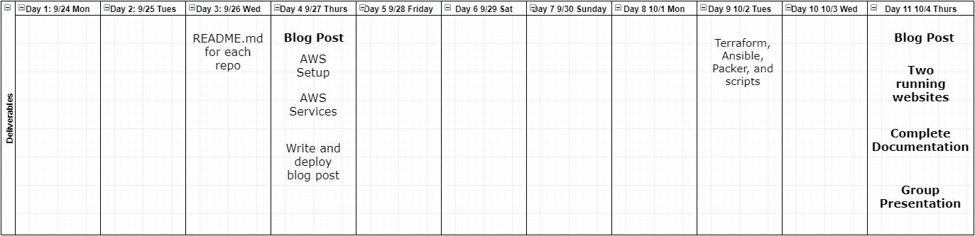
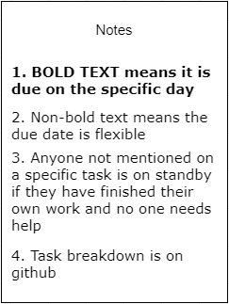
Project 2 - Example using the new system.

Slide 28
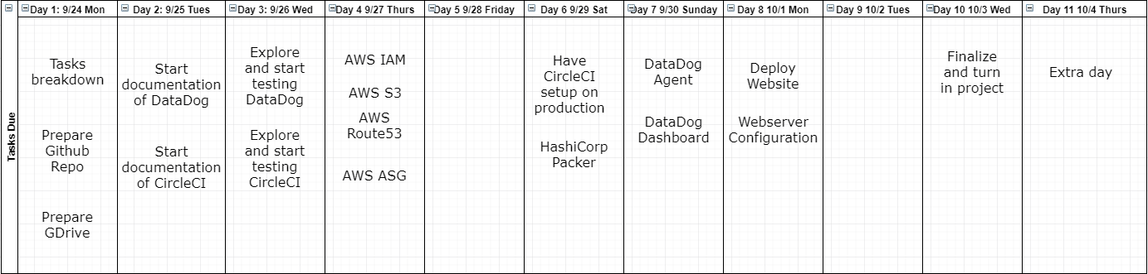
Project 2 - Example using the new system.

Slide 29
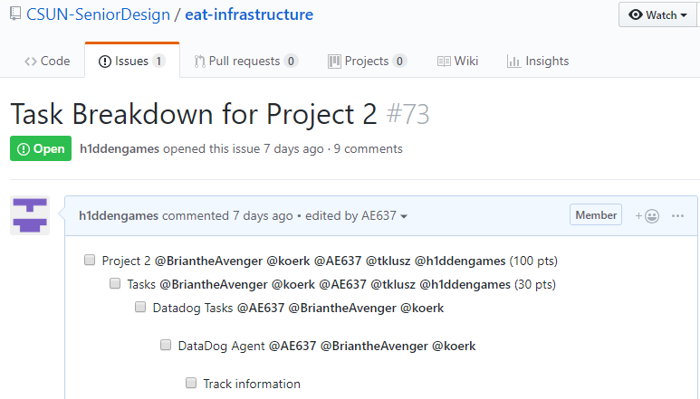
Project 2 - Example using the new system.

Slide 30
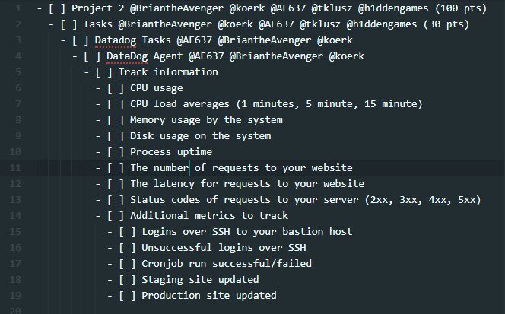
Project 2 - Example using the new system.

Slide 31
Project 2 - MVP(s)
A special mention to the two MVP’s of project 2:
Tyler for all his programming work in python to set up the AMI for the ASG section.
Erik for the many hours he put in trying to get datadog and packer to work properly.

Slide 32
Project Demonstration
(It's not complete… yet)

